Slide 1

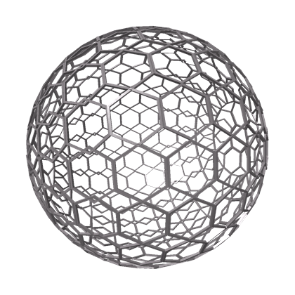
HyphaDHO
Hypha as a Living Organism (HALO)
We build dapps and tools to facilitate humanity’s transition to a globally regenerative and thriving civilization
Collaboration tools for the regenerative renaissance
Rieki Cordon
Joachim Stroh
August, 2020
Notes:
is to build a new organisation system that: 1. is fully decentralized from the point of censorship resistance (so Hypha can't be "shut down" or co-opted by current power structures). 1.1 from this angle it also needs to defend itself from those who wish to cause it harm, or abuse rewards (proxy accounts, wealthy, powerful, etc). 2. Create an organisation that can scale globally and allow a wide diversity of people to contribute in a myriad of ways and to earn a stake in this new organisation for doing so (so that it continues to decentralize overtime). By the people. 3. Create an organisational logic that other groups can plug into (creating an ecosystem of projects/orgs/groups/villages/bioregions/etc) that use similar organisational semantics (tools, value exchange, governance, etc) so that we can collaborate at scale to shift our civilizational story.

Slide 2
GAME OF HYPHA
Where do we start? Right here with this deck. It is the beginning of a journey (version 1) that will evolve over time. Each iteration will bring more clarity into the myriad ways we will create value, communicate & collaborate, build & fund, govern & decentralize the organization while being alive & present at the intersection of work, play & learn with radical honesty, transparency, responsibility and focus. This evolution is highly participative - each iteration will involve members of the organization in various roles and contexts.
GAME OF HYPHA
START
v1
GAME OF HYPHA
AMENDMENT
v2
GAME OF HYPHA
AMENDMENT
v3
How we create value for the organization
How we communicate & collaborate across the org
How we define, co-create & fund the organization
How we work-play-learn within the organization
How we govern & decentralize the organization
How we extend, replicate & fork the organization
CIRCLES
ROLES
POLICIES
PROTOCOLS
AGREE MENTS
ROADMAPS
DECISIONS
BUDGETS
TENSIONS
META GAME
1 BEGINNINGS
Notes:
Incentivize (employees and org), how do we grow, measure and validate impact

Slide 3
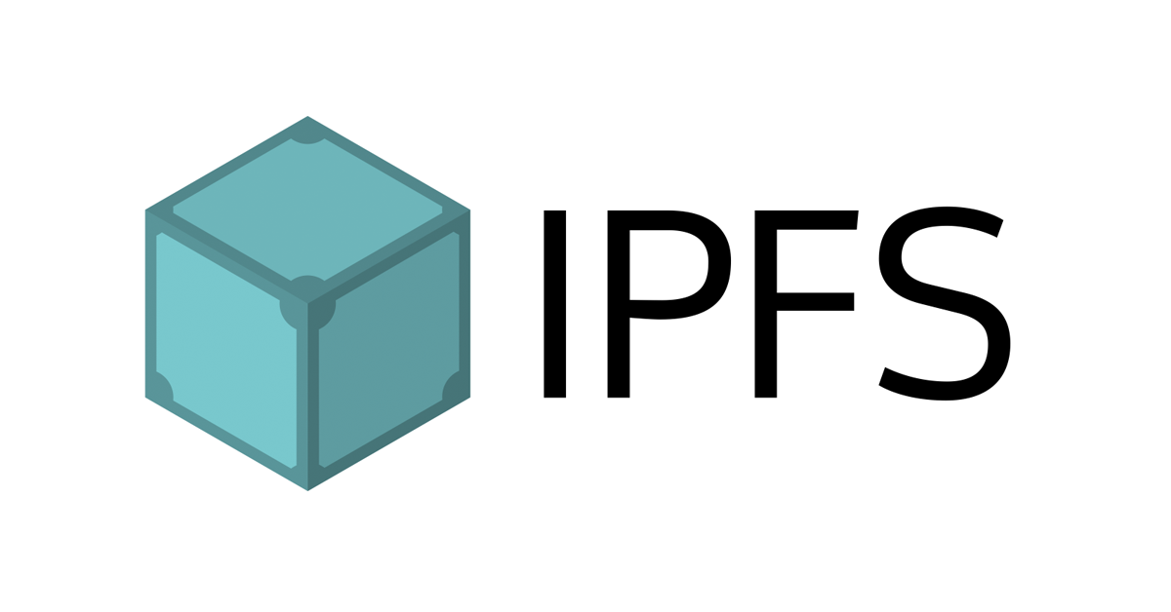



STATUS
V1 of document is current being proposed in the DHO. If passed, we have an active v1 stored in the IPFS (click on the card to open v1). Click on the YouTube link to watch an introduction to this slidedeck.
This is a living document, and will be continuously refined. We will highlight new slides and/or changes to slides with the stamps below.
GAME OF HYPHA
START
v1
1 BEGINNINGS
Notes:
Diffs listed here: Slide Value Creation -> More Risk changed to More Adventure

Slide 4
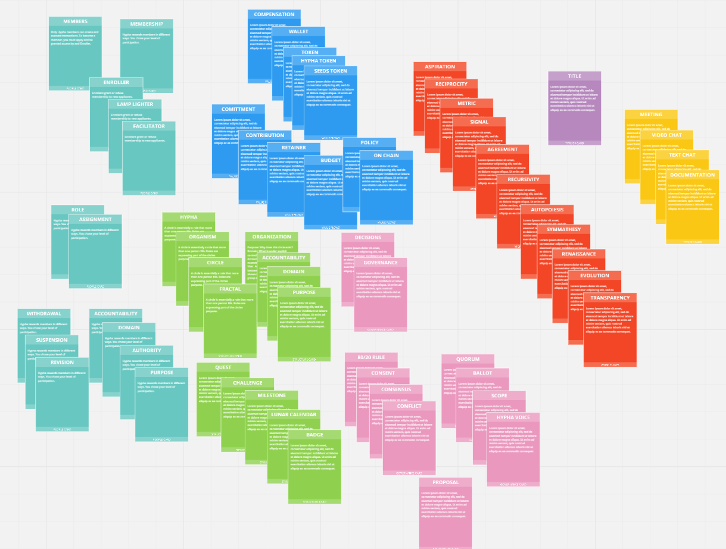

META GAME
We are introducing the Game of Hypha via a … game. Hypha is creating an ever growing deck of cards that introduces each concept/protocol/agreement as a separate card that can be added or removed from any “deck”. This meta game will evolve as we get more and more clarity around the agreements and definitions. Ready to play?
PLAY
1 BEGINNINGS
Notes:
rules have rulers, agreements have agree-ers - NH
http://polypoly.us/ - Keala
https://www.jornadax.com.br/lp-cadastro/en/ - Scott

Slide 5
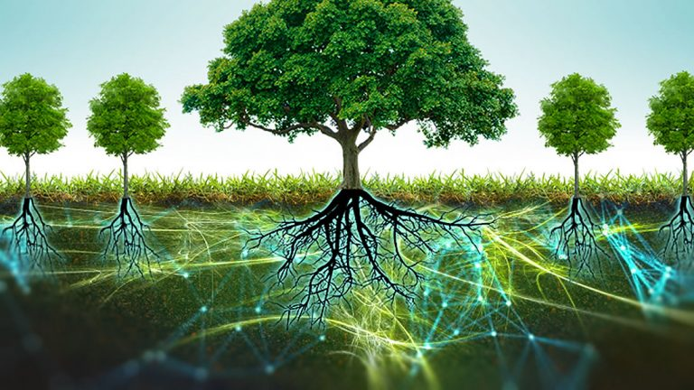
WHAT IS HYPHA? Hypha - Hyphae (plural) are the single “hairs” that make up a mycelial web. These webs are how healthy ecosystems transmit knowledge and resources across time and space. Hypha is here to provide tools to unite the myriad of organisations, movements, communities, etc to co-create a new global civilization towards a shared purpose of global regeneration.
H Y P H A
1 BEGINNINGS

Slide 6
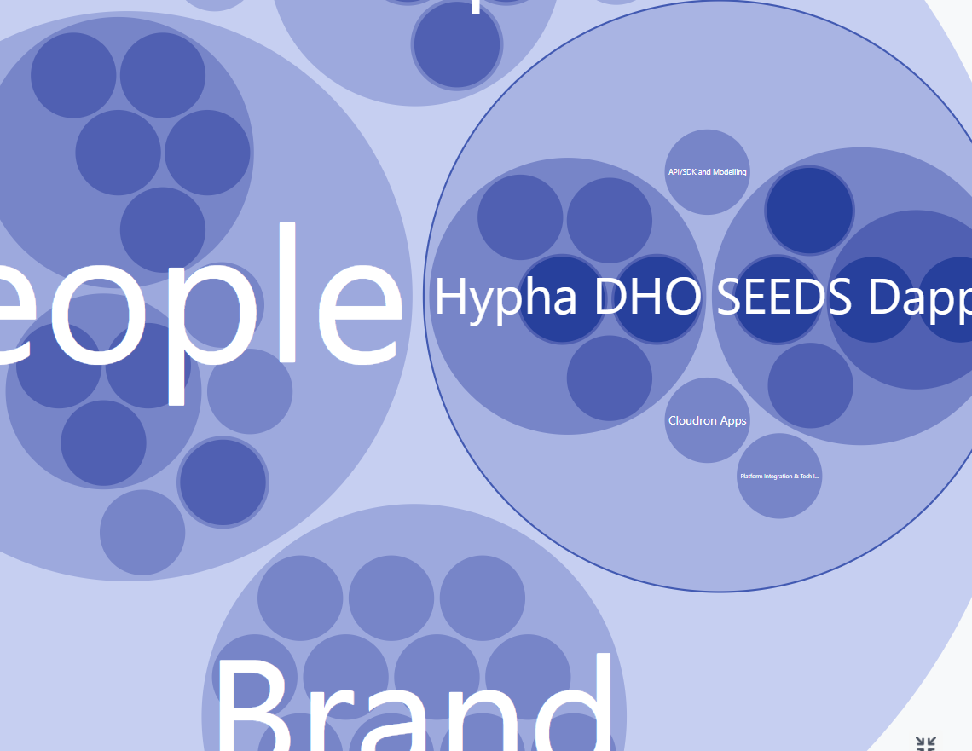
HYPHA DHO
The Decentralized Holonic Organism or Decentralized Human Organisation is the tool that Hypha uses to play this game - this is how we DO. Think of it as the gameboard on which we create.
The DHO is also fully decentralized, meaning its not stored on any central servers that can be easily hacked, shutdown or manipulated. Nobody owns the DHO - it is owned by all members! When the members make a decision in the DHO it is automatically executed (requiring no owners).
To visit the current DHO click here To see where the DHO is headed click here and here.
3 STRUCTURE

Slide 7


SIGNALS & AGREEMENTS
The Decentralized Human or Holonic Organization (DHO) is an organism that has the capacity to process signals and to enter into agreements with its members.
Only the DHO has the power to enter into agreements with Hypha and its members. If a member proposes or promises something, Hypha doesn't have the ability to "choose sides" - if a decision is made, it simply executes on it.
It always comes down to the governance of the DHO - that's the beauty and power of decentralized governance. Our collective task is to amplify the important signals to evolve our set of agreements.
HyphaDHO
SIGNALS
AGREEMENTS
Notes:
https://www.youtube.com/watch?v=dfe8tCcHnKY

Slide 8

TRUST
Hypha is setting out to build a purposeful organization based on trust. We are putting trust at the center of everything we do in the Decentralized Human and Holonic Organization (DHO).
The result is what Jordan Hall calls an anti-rivalrous playground for infinite games. The more it grows, the more anti-fragile the organization becomes. Any kind of competitive behaviour (even the healthy one) doesn’t make much sense anymore. There is no point in picking a winner or gaming the game or learning how to win.
Everyone and everything has its place.

Slide 9

Minimum Viable Decentralized Organization
Be a bridge to the new paradigm by being a living evolving experiment
Basic structure: simple structure to co-evolve from.
Build the change while living the change.
Model how organisations can be a regenerative, nurturing and equalizing force for good.
We do this through a continuous and subtle shift in how we collaborate and co-create.

Slide 10





Patterns for Co-Creation
Radical - (especially of change or action) relating to or affecting the fundamental nature of something; far-reaching or thorough.
Radical Honesty If you think, feel or know something - say something. We tell people and each-other exactly what we think and feel (constructively) and we welcome others to tell us exactly how they feel.
Radical Transparency Compensation, roles, commitments - everything is transparent. We commit to being open with our actions and deeds.
Radical Responsibility We are solely responsible for activating our roles purpose. We commit to embracing conflict as fuel for meaningful change in pursuit of purpose.
Radical Focus We focus on ambitions and objectives around our purpose and then process signals (perspectives) that are send back to us to act accordingly.
Notes:
Radical Focus - https://www.amazon.com/gp/product/0996006028/

Slide 11
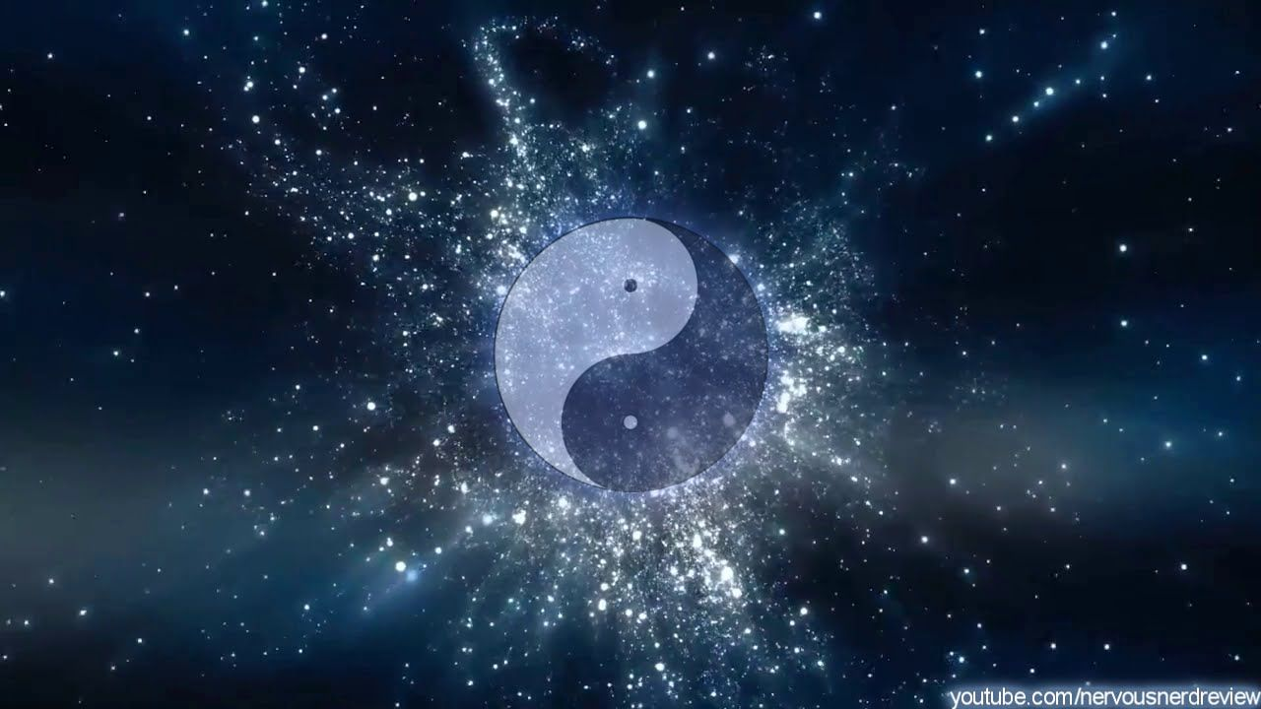
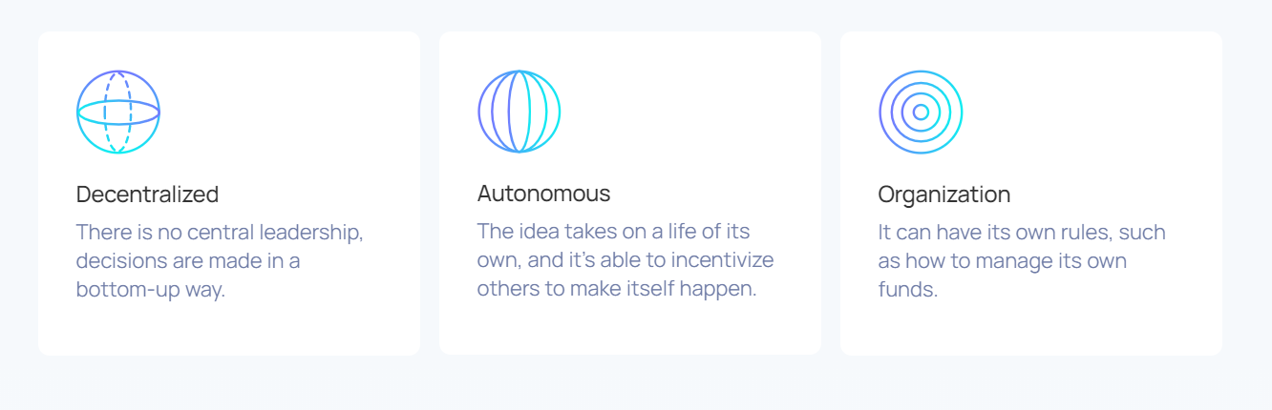
SKIN SOUL IN THE GAME
The 道DAO - The DHO - The Way
道DAO is the process of reality itself, the way things come together, while still transforming. All decisions, contracts and agreements go through the DHO. No single person has the ability to contract Hypha or make agreements. This is the function of the DHO!
You focus on being & doing rather than “talking”.
You are present and can detect the energy in the room.
You think about longer term impact rather than short term activities.
You align with the health (purpose) of the organization rather than being transactional (here and out).
You are in service to others, you are doing something for the sake of others.

Slide 12

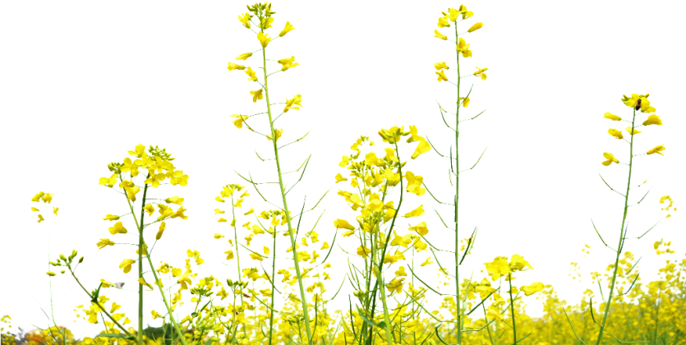

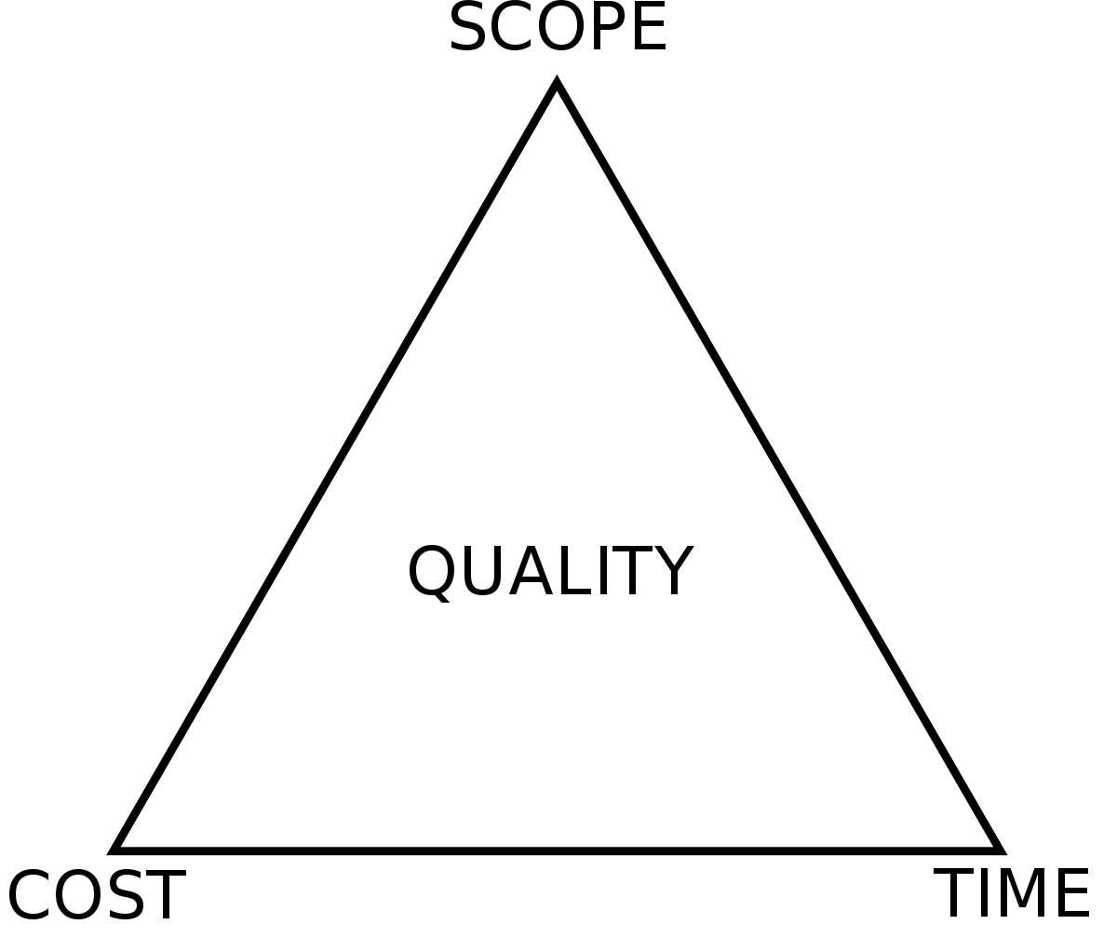
VALUE CREATION
In Hypha there are 3 ways to earn rewards for co-creating Hypha. Each method comes with its own trade-offs. More Continuity
You are thinking long-term commitment and others are counting on you to accomplish various tasks. More Freedom
You decide entirely how, where and when to contribute. Commitments are usually short-term / one-offs. More Adventure
You are drawn to the unknown by completing a (personal) challenge (group) quest and uncertainty of being compensated for your contribution.
More Freedom
Contribution or Referral
When you do something and then ask for compensation after the fact. In this case there was no official value agreed upfront and evaluation happens after the contribution occurs.
VALUE
Role Assignment
You hold a specific role in Hypha. Compensation and responsibilities are clear and agreed upfront. Evaluation is continuous as other members decide whether to suspend or continue your role.
Quest or Challenge
You agree to a specific one-time task that has a reward (or booty) associated with it. Evaluation of success and rewards are distributed after various milestones are (or the whole quest is) done.
More Continuity
More Adventure
Likelihood to succeed in earning a reward
LOW
HIGH
Needs more thinking… JS
Revised now.. What think.. JS
Notes:
Note: contributions are not genesis contributions (tied to a role)
Commission-based
Salary-based
Ad-hoc compensation
Promissory-based

Slide 13
VALUE
CREATION
CONTRIBUTION REQUEST
...when you do something and then ask for compensation after the fact. In this case there was no official value agreed upfront and evaluation happens after the contribution occurs.
High freedom as you get to decide how/when to contribute. Higher risk as it may not pass.
Contribution Request
DECENTRALIZED ASSESSMENT
A contribution request can have a “sliding scale” for what that contribution could receive. Members vote “no” or “yes” for the contribution and if “yes” they also determine where on the scale this contribution is worth. In this way we reduce the need for a proposer to determine the exact value of a contribution.
Freedom
Low
High
Responsibility
Financial Risk
Notes:
This is what excites me about "Gratitude Tokens" and employing them (and other tools (TBD)) to assist in this Decentralized assessment and contribution accounting. We must remember we're all Hypha and if Hypha is always taking on all the risk this is a classic case of "tragedy of the commons" and we'll all fail. Meaning, people can't just show up, do something and always expect to be paid (if it wasn't agreed upon by Hypha) the only official contract/agreement in Hypha is in the DHO! That's where agreements are made and stored transparently and immutably. If someone wants their "potential" contribution paid upfront - they can attempt this approach with proactive contribution request.

Slide 14
VALUE
CREATION
QUEST REWARD
… when you agree to a specific one-time task that has a reward (or booty) associated with it. Evaluation of success and rewards are distributed after various milestones are (or the whole quest is) done.
Freedom to accomplish quest as you see fit and medium risk for rewards.
Quest Reward
DECENTRALIZED ASSESSMENT
A quest reward can have a “sliding scale” for what that contribution could receive. Members vote “no” or “yes” for the contribution and if “yes” they also determine where on the scale this contribution is worth. In this way we reduce the need for a proposer to determine the exact value of a contribution.
Freedom
Low
High
Responsibility
Financial Risk
Notes:
This is what excites me about "Gratitude Tokens" and employing them (and other tools (TBD)) to assist in this Decentralized assessment and contribution accounting. We must remember we're all Hypha and if Hypha is always taking on all the risk this is a classic case of "tragedy of the commons" and we'll all fail. Meaning, people can't just show up, do something and always expect to be paid (if it wasn't agreed upon by Hypha) the only official contract/agreement in Hypha is in the DHO! That's where agreements are made and stored transparently and immutably. If someone wants their "potential" contribution paid upfront - they can attempt this approach with proactive contribution request.

Slide 15
VALUE
CREATION
ROLE ASSIGNMENT
… when you hold a specific role in Hypha. Compensation and responsibilities are clear and agreed upfront.
Evaluation is continuous as other members decide whether to suspend or continue your role.
Lower freedom (specific tasks), high responsibility and lower financial risk.
Role/Retainer Assignment
DECENTRALIZED ASSESSMENT
Roles have a recurring contribution associated with them. However, roles and members also have the ability to earn “Gratitude” from other members which can increase their compensation.
Freedom
Low
High
Responsibility
Financial Risk
Notes:
This is what excites me about "Gratitude Tokens" and employing them (and other tools (TBD)) to assist in this Decentralized assessment and contribution accounting. We must remember we're all Hypha and if Hypha is always taking on all the risk this is a classic case of "tragedy of the commons" and we'll all fail. Meaning, people can't just show up, do something and always expect to be paid (if it wasn't agreed upon by Hypha) the only official contract/agreement in Hypha is in the DHO! That's where agreements are made and stored transparently and immutably. If someone wants their "potential" contribution paid upfront - they can attempt this approach with proactive contribution request.

Slide 16
Roles and Assignments
Roles Created by Hypha Members - a signal for what we need. By voting this in we're signalling that this role can be filled and a contribution paid.
Requirements:
Purpose - Why does it exist?
Circle -Where does it exist?
Accountability - What does it do?
Domain - What does this role control?
Compensation (fair market value + bands)
Assignments People can choose what percentage of a role to fill this is where members determine if the “soul” is right for the “role”. Members update regularly (with each evaluation period) to best reflect their contributions.
Requirements:
Start Date
Evaluation Date (revote required)
Percentage filled

Slide 17
Orientation
1 You apply for membership in the org (questionnaire/relationship) 2 Level up gets to know you (personality/experience) 3 You get to know the org (reading/learning/playing) 4 Level up sets a complexity level B1-7, with modifier for more HUSD/SEEDS/HYPHA/HVOICE (see matrix) 5 You begin in an assignment for set level with above growth function 6 You earn additional badges/multipliers on the way

Slide 18




PURPOSE
In the beginning, there is a shared purpose that is attracting people.
Hypha’s PURPOSE Build tools to facilitate humanity’s transition to a globally regenerative and thriving civilization.
PURPOSE

Slide 19


THE SOURCE
The first person to embrace the purpose and to step into a circle is the Source. The task is to recognize you cannot do this alone and to shine some light on the first circles of the organization defining an early structure and purpose that will be filled in by other people that feel attracted to it.
We call this role a Lamp Lighter.
CIRCLE
CIRCLE

Slide 20
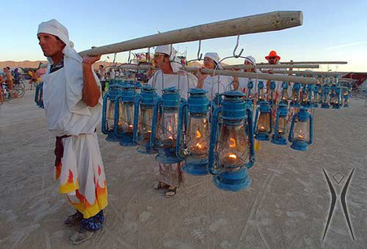
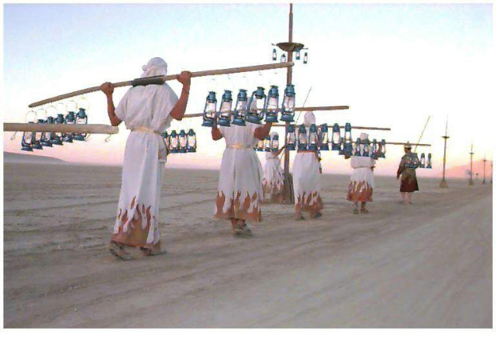
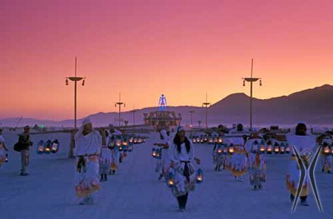
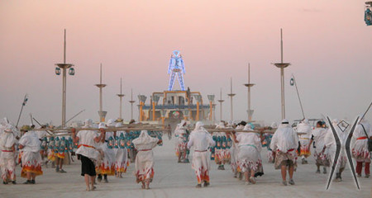
LAMP LIGHTERS
“Lamplighters have been an important part of Burning Man almost as long as Burning Man has been held in the desert. More than a public utility, the Lamplighters are a symbol of community, of participation, and clear sign that the day has passed, and that evening magic will soon be upon us.”
For us, lamplighters are holding an important link lead function of the circle to illuminate, to navigate and to celebrate our work. Picture each lantern carried further into the circles of the organization. h/t Nikolaus Heger

Slide 21

CIRCLES
A circle is essentially a role that more than one person fills. Roles are expressing part of the circles purpose.
Purpose: Why does this circle exist?
Domain: What is under explicit control of that circle?
Accountabilities: What is this circle expected to accomplish? Size: As a rule of thumb, circles are between 4-12 people. Research shows that 5-7 people are ideal group sizes for effective action.
C
C
C
CIRCLE

Slide 22
ROLES
People have different skills and experiences reflected in roles. Bear in mind that you only need to bring those experiences and skillsets to the circle that are part of your roles’ accountability, domain, and purpose.
Hypha’s Roles Purpose - Why it exists Domain - What it exclusively controls
Accountability - What can be expected of this role Capacity - How many people fill it Compensation - Based on fair market values + Hypha contribution bands
WORK TEAM CIRCLE
WATER COOLER CIRCLE
Related to your role
R
PERSONAL NEEDS AND WANTS
Not related to your role
Related to another role
WORK TEAM CIRCLE

Slide 23

ROLES
You are here as a wholesome human with all of your skills & experience. The purpose-driven organisation enables you to connect to who you are. It is a slice of your best skills and traits applied to the context of a role and a circle.
Your Role is not your Soul
Your residual self is the concept that individuals tend to think of themselves as projecting a certain appearance, or certain position of social entitlement, or lack thereof. As you move from role to role your residual self becomes more and more pronounced.
Applied Role
Agreements
Residual Self
Who you are as an individual (Your Soul)
What we reward in the organization (Your role)
Notes:
Residual. Residual self-image is the concept that individuals tend to think of themselves as projecting a certain physical appearance, or certain position of social entitlement, or lack thereof.
https://unsplash.com/photos/O3ymvT7Wf9U

Slide 24



BODY OF PEOPLE MEETS BODY OF WORK
By separating the Body Of People from the Body of Work we gain both flexibility & fluidity of matching the right skillsets & experiences to the complexity of the needed role.
Between the two is a strong attraction that will ensure that the level of commitment matches with the assignment at the right level of complexity.
A person at complexity level 1 will be attracted to an assignment at complexity level 1, likewise with higher levels. This does not preclude a circle to choose a lower level skillset for a higher complexity assignment.
Value Creation
Body of People
Who
What
Body of Work
Skills & Experiences
Complexity of Role
Wants
Needs
Value Exchange
Notes:
Skills and experience are overrated, wisdom and seniority are not (vertical salary bands)

Slide 25
Duties
As soon as anyone takes on a role in the DHO, they agree to fulfil these duties.
Sensing
The duty to process any and all relevant tensions sensed into meaningful change in pursuit of the purpose of their roles.
Processing
The duty to process, take on and prioritize in accordance with circle strategy any work request your role is accountable for.
Expectations
The duty to sense into and make explicit through governance any implicit expectation if in service of purpose or transparently declining the expectation.
Transparency
The duty for transparency to any other role on all the work your are engaged in at any given time and upon request provide reasonable estimates when deliverables can be expected.

Slide 26





COMM PATTERNS
A large variety of communication patterns and channels exists for every organization. People can easily feel overwhelmed (or underwhelmed) - so chose your participation wisely. Don’t try to be in every channel, respect the privacy of existing circles and reach out to people directly for feedback. Remember, all feedback is just suggestions, and roles need not take that feedback in.
Create a Water Cooler channel to allow for any non-work or non-role related conversations.
Start Working Out Loud to share some of your work experiences with others in the organization.
Reach out with a Direct Message to your fellow members for an issue you have/want to resolve.
Set your channel to Read Only and leave one guest channel open for writing.

Slide 27
ROLES HAVE POWER! Roles have clear authority to execute within their purpose and domain. Roles only need to seek permission from others if it breaches the domain of another role. When a role splits into multiple roles - the domains and accountabilities are divided amongst the new roles.
I want to garden too!
B
D
B
From role to circle
E
“Role” B Gardener
Purpose
Grow Plants
Role B Accountabilities
Make Soil
Plant Seeds Domain
Gardens (Nursery and Soil)
Accountabilities
Role D
Make Soil
Role E Plant Seeds
Domains
Role D
Soil
Role E Nursery
“Circle” B Gardeners
Purpose
Grow Plants
Roles Act!
The power is held in a role to act
No permission needed to act within domain and purpose
May seek advice - but not mandatory (circle/org consensus is not needed!)
Circles Coordinate
Circles evolve roles, suggest new roles, evolve governance processes When no rule exists - circles can create new rules, set up working groups, etc
Notes:
ACTIVATING Roles so they are empowered to take action and know what they can do - then get out of the way... We're not here to micromanage each-other on the day-to-day the DHO and governance structures are intended for the structure to help with that.

Slide 28
SUMMARY OF THE PROCESS
It all starts with a purpose and the source. Add circles and roles. Rinse and repeat.
PURPOSE
CIRCLE
RECIPROCITY
RECIPROCITY
RECIPROCITY
ASPIRATION
ASPIRATION
PURPOSE
LAMP LIGHTER
STRUCTURE
CIRCLE
ROLES
DOMAIN
Notes:
Owner = Coherence Holder
Firefighters have “hierarchy”
Very first person in this role is the source
https://medium.com/@AhoiNadjeschda/who-s-idea-was-it-anyway-the-role-of-source-in-organizations-843b407e2879
https://www.youtube.com/watch?v=32vlOgN_3QQ

Slide 29
AUTOPOIESIS | SUMMARY OF THE PROCESS
It all starts with a purpose and the source. Backbone of 2 to 7; circles and roles. Rinse and repeat.
CIRCLE
PURPOSE
PURPOSE
PURPOSE
LAMP LIGHTER
SHARED PURPOSE
CORE CIRCLE
Dream Sharing “backbone”
DOMAINS STRUCTURE
DOMAIN
Micro-Roles and Challenges shape the activities
CIRCLES & ROLES
CIRCLE
Circles and Roles formation gives shape to Domains of Work and Purpose
Notes:
Domains respond to internal and external stimulus and are "morphogenetic fields". They are "Organs is the Organism". Among other aspects they are natural separation of concerns. The domains aggregate individuals, around a share "skill set"; ability to give response to the stimulus. The structure crystallises when the stimulus needs response; the skill set is right to the level of response needed and the purpose of response is shaped, and finally when there are minimal 2 individuals dyad.
Owner = Coherence Holder
Firefighters have “hierarchy”
Very first person in this role is the source
https://medium.com/@AhoiNadjeschda/who-s-idea-was-it-anyway-the-role-of-source-in-organizations-843b407e2879
https://www.youtube.com/watch?v=32vlOgN_3QQ

Slide 30
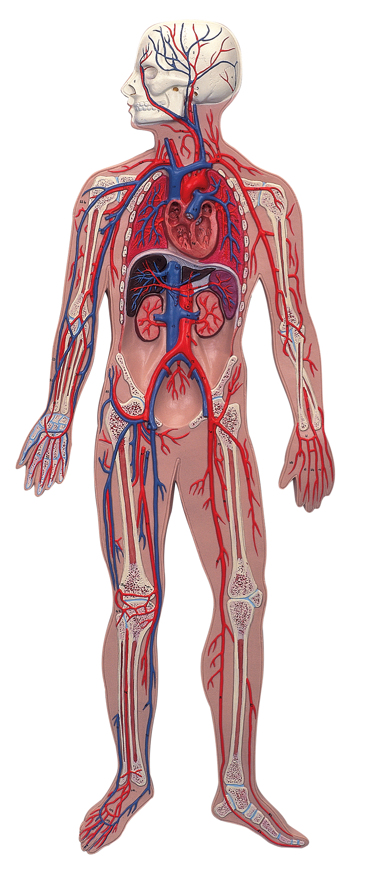
Human Organism
Hypha Organism
Cells/organs are autonomous units managing their own health in relation to the whole.
Roles/circles are autonomous units managing their own health in relation to the whole.

Slide 31
ORGANISM
New people are showing up and form new circles and roles or move around.
Moves require circle consent!
CIRCLE

Slide 32
ORGANISM
New people are showing up and form new circles and roles or move around.
The members can signal what roles they need filled, even if there is noone to fill those roles yet.
Empty Role

Slide 33
VOTE WITH YOUR ROLE
Change roles, circles and/or create new ones...
You’re sensing what’s needed and wanted...
Go out and do it! Voice holders decide if it’s valuable
or not and determine resource flows.

Slide 34
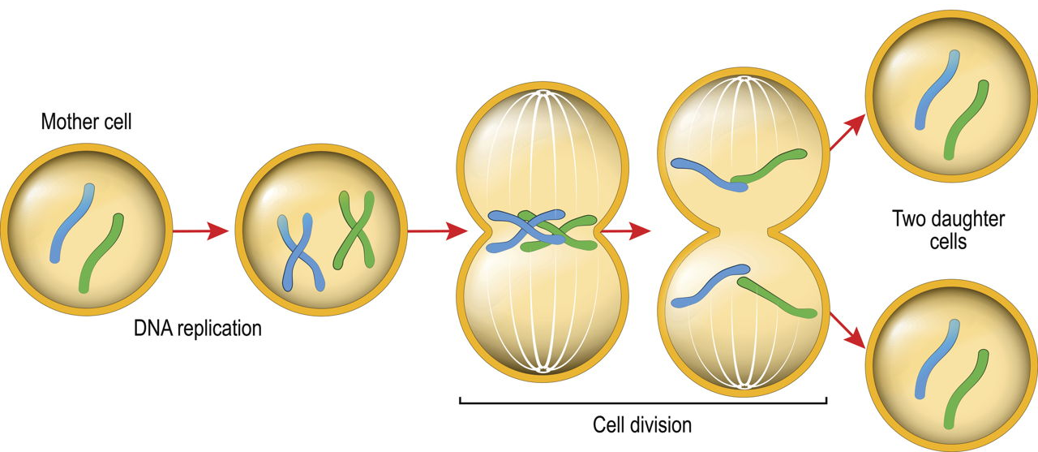
CELL SPLITTING / EVOLUTIONARY TENSION
As circles grow there may come a time when 2 “camps” emerge within the membership that see two conflicting approaches to serve purpose. If finding “a better 3rd solution” fails - a split may be needed: This can happen in at least 2 ways: 1. Creating a new circle (new purpose) (new budget) 2. Forming 2 distinct sub-circles (same purpose, different approach) (same budget)
Sub Circle
New Circle

Slide 35
DECENTRALIZED ASSESSMENT
Roles govern in their relevant context. Within circles or the whole organism. When a new circle or role wants to form outside of a specific circle. All members vote. When a new role wants to form inside a circle - only members in that circle vote. Complex, adaptive and emergent assessment criteria form to govern new roles, circles, assignments, quests, etc
INSIDE
CIRCLE
OUTSIDE
YES! Because C,D,E
NO! Because X, Y, Z
What do I think is relevant for something to get my vote?
Yes! Because A, B, C

Slide 36
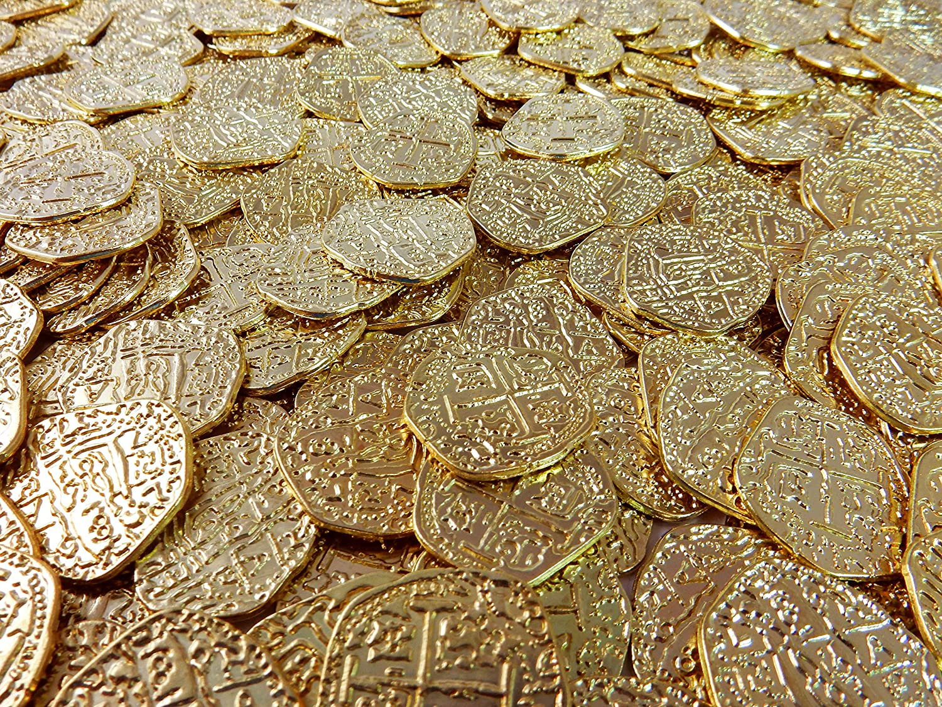
BUDGETS
Living budgets constantly adapt to the environment and allow changes to the organism in real-time. Provides the foundation for healthy competition amongst circles and roles in pursuit of purpose - rewarding successes and thriving organs and removing stagnation & parasites.

Slide 37
BUDGETS
Budgets set natural boundaries to growth (or detox). Roles / Circles gain and maintain a budget by how well they’re executing and providing value to the whole. This requires some signal work to showcase value added.
This process prevents 2 common cliche failures:
“Construction workers extending jobs (paid by the hour).”
“Military contractors wasting resources (to justify a budget).”
Notes:
We know the cliche around construction workers (extending jobs)… We also know cliche around military budgets (wasting resources)... So, this is why we can act in %’s (easier to quantify) then people raise and lower %’s based on where they feel value needs to flow and who’s adding value.

Slide 38
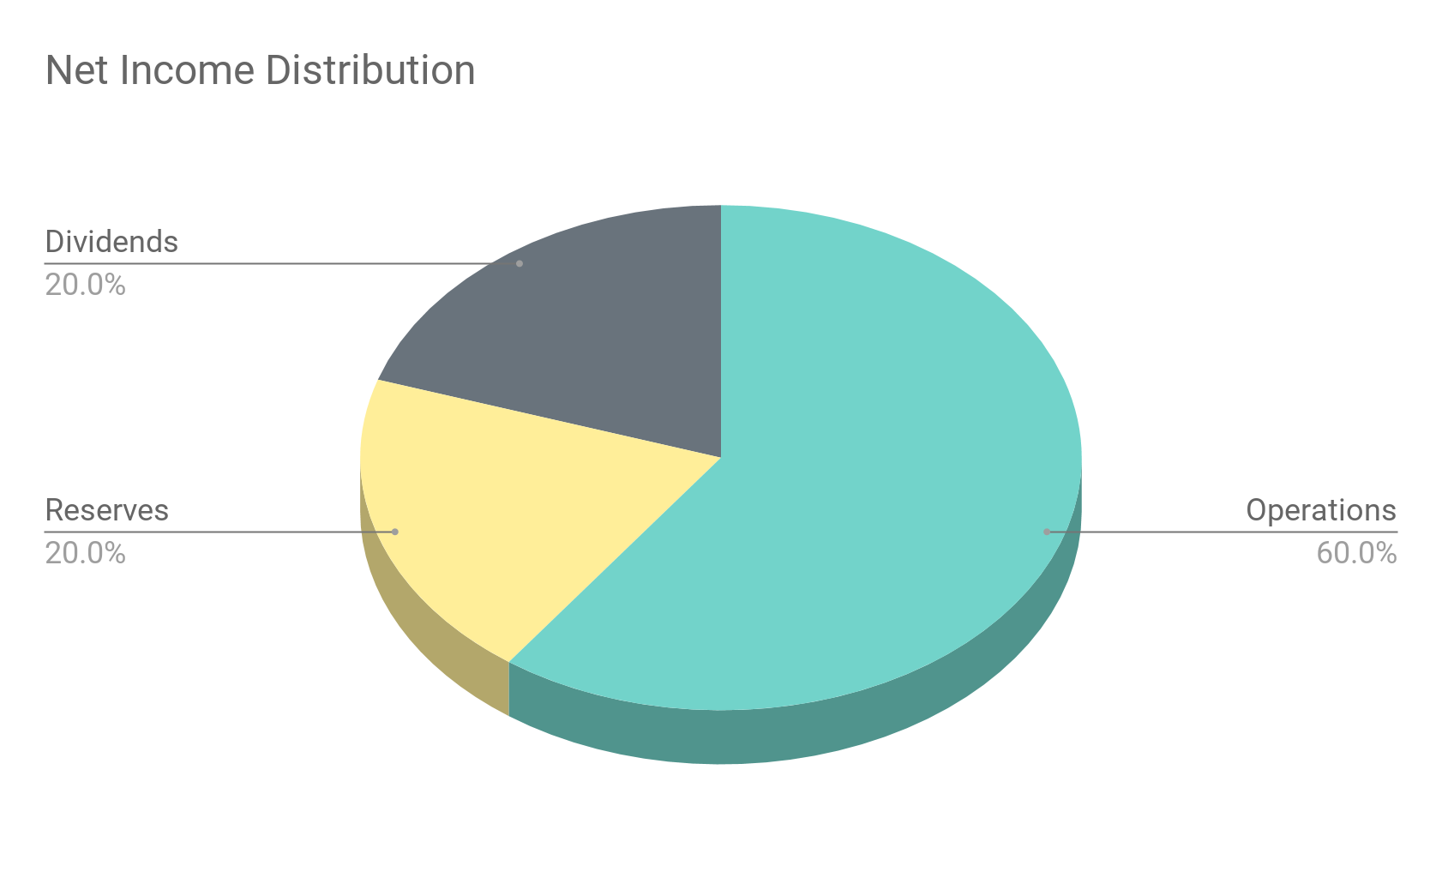
DECENTRALIZED BUDGETING
| Step 1: How do we spend income and investment?
First the whole organism decides how to direct organism resources for 3 main buckets.
Dividends
To reward Hypha equity holders and redistribute equity.
Reserves, Quests, etc For quests, contribution requests, other expenses and reserves. Roles To payroll compensation.
*Achieved using any of the upcoming budget assessment tools.
Example
Notes:
Encourage cell splitting So what does this look like from an organisational lense New cells can emerge

Slide 39
DECENTRALIZED BUDGETING
| Step 1.1: Income Dividend bucket goes two places:
Hypha Equity buy-back and redistribution.
To buy equity (an equal % from all equity holders) and distribute it to current Hypha members (relative to contribution).
Dividends to Hypha Equity holders
This balance of redistribution and dividends aligns the interests of the current Voice holders to maintain a healthy dividend bucket and trends Hypha towards further equity decentralization.
I’m new here and I just earned equity!
Current Roles
Equity is purchased from current holders and redistributed to current contributors, ensuring equity is passed down the generations.
Giving Hypha Equity...
50% as equity buyback
Example
Giving Seeds...
Equity Holders
50% as dividends
Giving Seeds...
Notes:
Encourage cell splitting So what does this look like from an organisational lense New cells can emerge

Slide 40
DECENTRALIZED BUDGETING
| Step 2: How do we distribute role compensation and which circles do we resource?
Budgeting through voice. Anyone (or circle) may publish budget recommendations. But the decision is made by all.
How do I think the organisation should direct our shared resources?
50%
20%
Circles/ Roles Selling their function and successes to applicable Voice Holders to encourage them to continue giving them funds.
30%
Autonomy, Diversity, Evolution
New roles and projects can emerge and get funded as Voice Holders steer and shape the organisation and where resources flow
Notes:
Encourage cell splitting So what does this look like from an organisational lense New cells can emerge

Slide 41
DECENTRALIZED BUDGETING
| Step 3: How do circles distribute their funds?
Circles decide how they spend their budgets accounting for: Quests & Contributions
For anyone to add value to the purpose and mission of the circle - to contract other parties or to reserve for other reasons. Role Compensation
To pay for role assignments.
How do I think the circle should direct our shared resources?
Notes:
Encourage cell splitting So what does this look like from an organisational lense New cells can emerge

Slide 42
DECENTRALIZED BUDGETING
| Sensing Circles and roles sense to the whole organisation what they need to thrive. All members sense where they would like to direct shared resources.
We think the budget could be...
The circle needs...
My role thinks we should fund...
Notes:
Encourage cell splitting So what does this look like from an organisational lense New cells can emerge

Slide 43
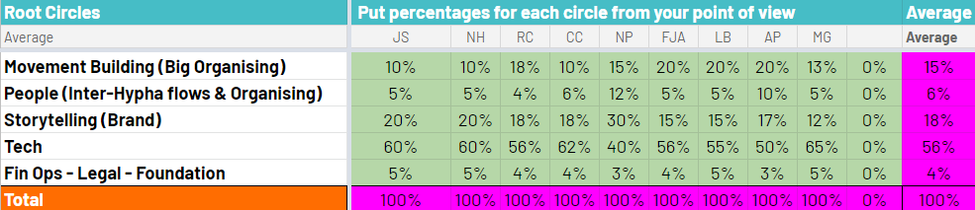
DECENTRALIZED BUDGETING
| Deciding Realtime - cyclical living and self organising budget
1. Each member creates their own ideal budget (either following a recommendation or on their own). 2. This suggestion is multiplied by that members HVoice holdings.
3. Only major organs (circles) need to voted on by all, then circles handle their own budget.
4. Caveats - to limit manipulation most extreme suggestions could be removed.
Organism Budget
Organ (Circle/Role) Budget
Dividends
Root Role 1
Low
High
Low
High
Operations
Root Circle 1
Reserves
Root Circle 2
Live Example
Notes:
Everyone collectively makes a proposal - people’s selections are transparent so we know if people are gaming it… Further we can remove 10% outliers for each section Suggestion Multiplied by the voice of the account and updated real time to payout a budget cyclically. Takes the average. If less than 0.5% it is removed. Or takes the median… Smaller number of “ROOT” circles for initial budgeting. So to avoid burnout/overwhelm.

Slide 44
Human Organism
Hypha Organism
Wanting to run? More blood to the muscles. Just ate a meal? More blood to the gut.
Preparing for a launch? More funds to Marketing Circles.
Excited for new features?
More funds to Tech Circles.
Adaptive and Agile Sensing

Slide 45




DECENTRALIZED BUDGETING
| Deciding
Option H Cyclical fixed proposed budgets
1. Members (or circles) propose various fixed budgets. 2. Members vote on which budget to pick their assessment is multiplied by their HVoice.
3. Drawbacks - requires members (or circles) to prepare and propose a budget.
4. More ideal for budgeting within Circles to keep within recurring contribution requirements.
proposal 1
Low
threshold
Practical (0,0)
proposal 3
proposal 2
proposal 4
(0.8,0.2)
paths
attracted (1,0)
repulsed (0,1)
Proposal 2
Proposal 1
Collective assessment (collective assessments)
Proposal 3
Unpractical (1,1)
Self-
Assessment
(individuals)
Notes:
Everyone collectively makes a proposal - people’s selections are transparent so we know if people are gaming it… Further we can remove 10% outliers for each section Suggestion Multiplied by the voice of the account and updated real time to payout a budget cyclically. Takes the average. If less than 0.5% it is removed. Or takes the median… Smaller number of “ROOT” circles for initial budgeting. So to avoid burnout/overwhelm.

Slide 46

FRACTALS
& APPEALS
Fractals reflect a portion of the parent all the way down. This can be budget, purpose, governance or voice. The only decision of the full organization is bootstrap the process, e.g. how to allocate funds to the root circles.
Fractal Governance:
Each successive domain can appeal to the parent domain for any governance or policy decisions.
Fractal Budgets:
Each successive domain can appeal to the parent domain for budget decisions.
Budget
Governance
Budget
Governance
Budget
Governance
Budget
Governance

Slide 47
OBJECTION & APPEAL
1. Discuss with role or circle holding the domain where there is a tension (if this exists).
e.g. discuss with Storytelling circle about the Logo
2. If tension isn’t resolved you can propose a change to the game, or a one-time policy shift to address your tension in the DHO.
e.g. propose in the DHO to take the Logo out of the sole domain of the Storytelling circle
3. All members then vote to change the game or amend a new policy.
e.g. all members vote on whether we should bring the domain of the logo into the whole Hypha
4. If game change proposal is successful all members can then propose any number of solutions to move forward.
e.g. any member can propose a new logo, or propose a solution of keeping the logo within the domain of Storytelling, or any other solution.
5. Members then can interact on **all** proposed solutions.
a. Vote Yes if you support
b. Vote No if you want to block C. Vote Abstain if you feel it’s “good enough to try”
c. Don’t vote if you don’t support
6. The proposal with the most support is adopted - if there is a tie with unity - the proposal with the highest quorum is adopted.
Notes:
Proposing to add to the Game of Hypha an official objection process:

Slide 48

TENSIONS
A tension is a mental or emotional strain. In our context, a tension is a personal experience: a symptom of dissonance between an individual’s perception of a situation, and their expectations. Tensions can arise in individual, team and organizational contexts. To discover sources of tension, investigate what stimulates it, and describe what’s happening and what’s expected. Sometimes a simple inquiry reveals misperception and the tension goes away.
Process goes here
Notes:
Proposing to add to the Game of Hypha an official objection process:

Slide 49
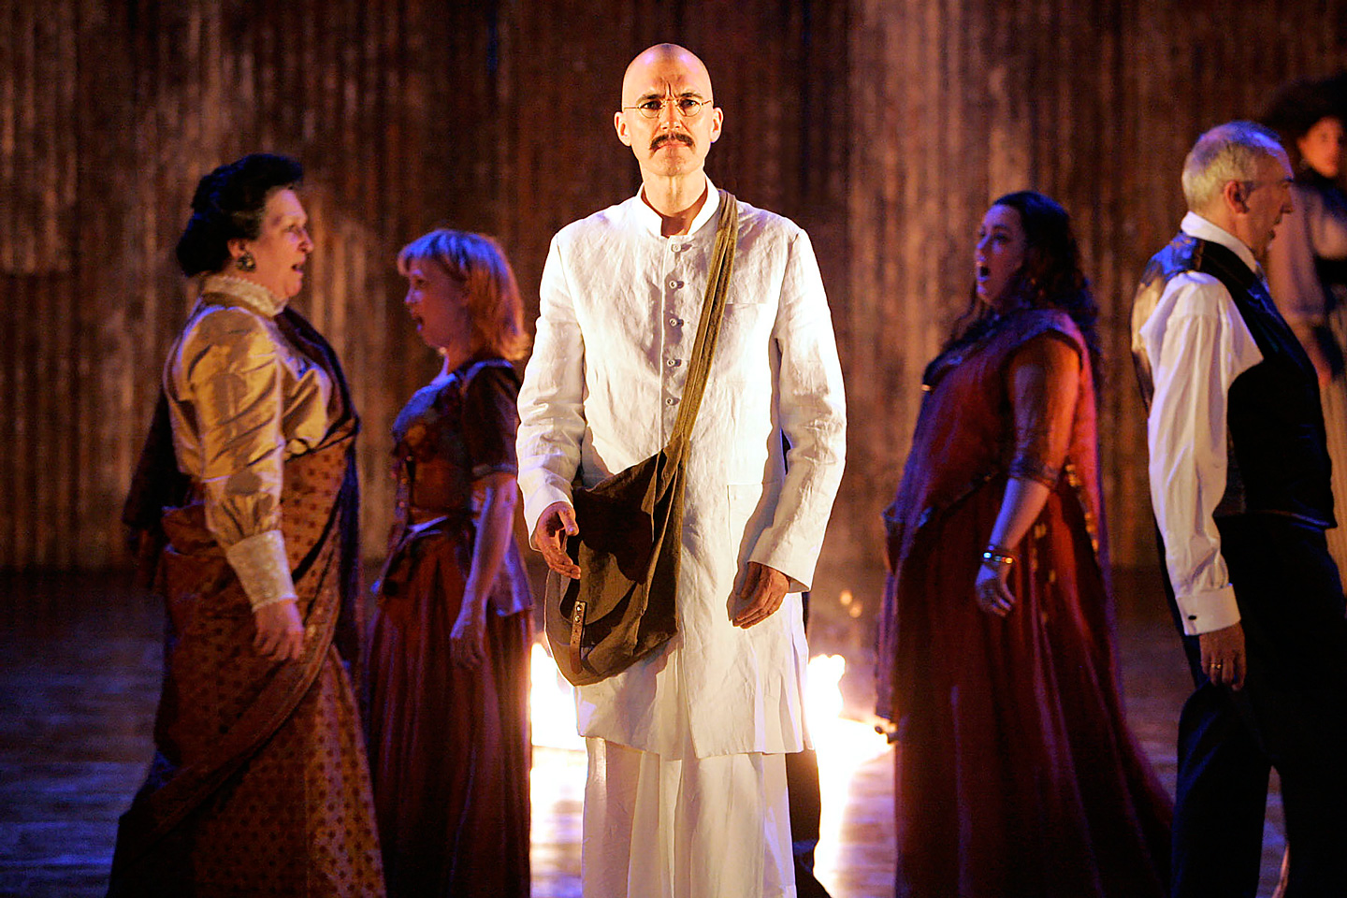
OBJECTION & APPEAL
Important decisions are made by consent, defined as having no “reasoned objections”. In English, objection means “This decision can’t go forward.” In other languages it has the meaning of difficulty, problem, trouble, bother, or nuisance. Circles solicit objections because they provide valuable context and information. Reasoned objections have a clearly stated rationale, allowing circle members to understand the basis for the objection and to take collective responsibility for possible resolutions.
Process goes here
Notes:
Satyagraha, opera by Philip Glass

Slide 50
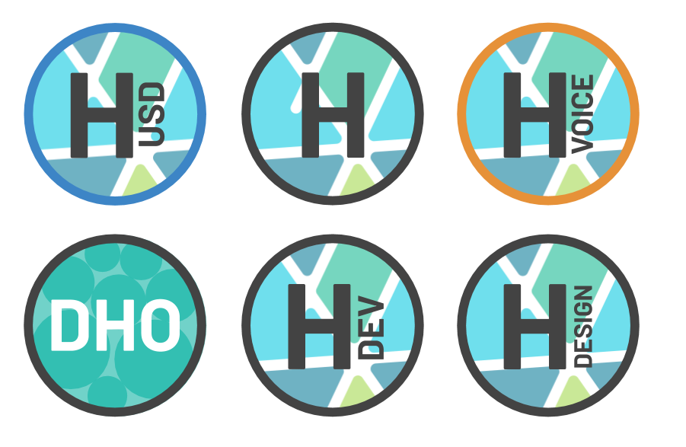
HYPHA VOICE
Hypha Voice (HVOICE) is a token that cannot be traded and must be earned. It is earned through adding value or upleveling your wisdom and comes with a half-life of 1 year (biasing governance towards those adding more recent value).
This way Hypha moves beyond the typical oligarchies and plutocracies (governance by the wealthy) of today’s corporations and even nation states.
By having voice be earned, the people who are contributing the most (and thus have the most awareness of what the org needs) have the most voice.
The more value I add the more Voice I get!
I love having a direct voice, I want to play more!
Notes:
Token = Voice or Reputation

Slide 51
HYPHA VOICE
If budgets are coming from the “outside in”, voice is coming from the “inside out” to maintain a balance.
1 Token 1 Vote (current)
1 Circle Role 1 Vote (planned)
1 Account 1 Vote
1 Human 1 Vote
My voice counts only in the circles I participate in.
1T1V
1CR1V
80%
1A1V
1H1V
Voting Methods/Scopes
80/20 | CONSENT | CONSENSUS t=fixed, t=until min% threshold
20%
Notes:
Token = Voice or Reputation

Slide 52
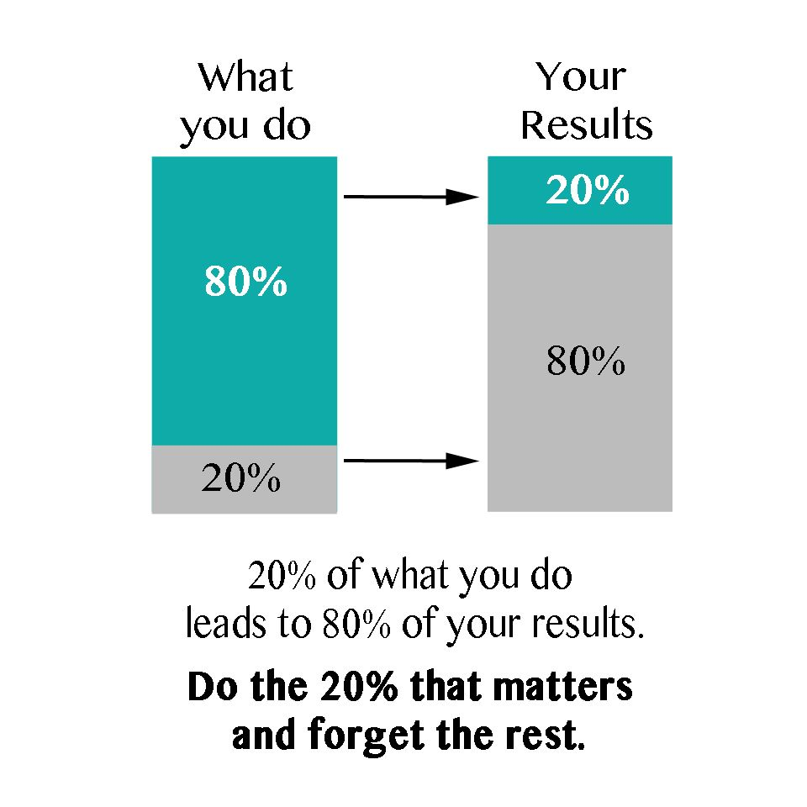

80/20
Many different voting methods can co-exist. Circles set natural boundaries for their scope.
We need 80% of endorsement and 20% of participation (called a quorum). If we pass this threshold the vote passes.
80/20/1T1V/1WK
80% pass (Unity)
20% quorum (HVoice Voting)
Notes:
Token = Voice or Reputation

Slide 53
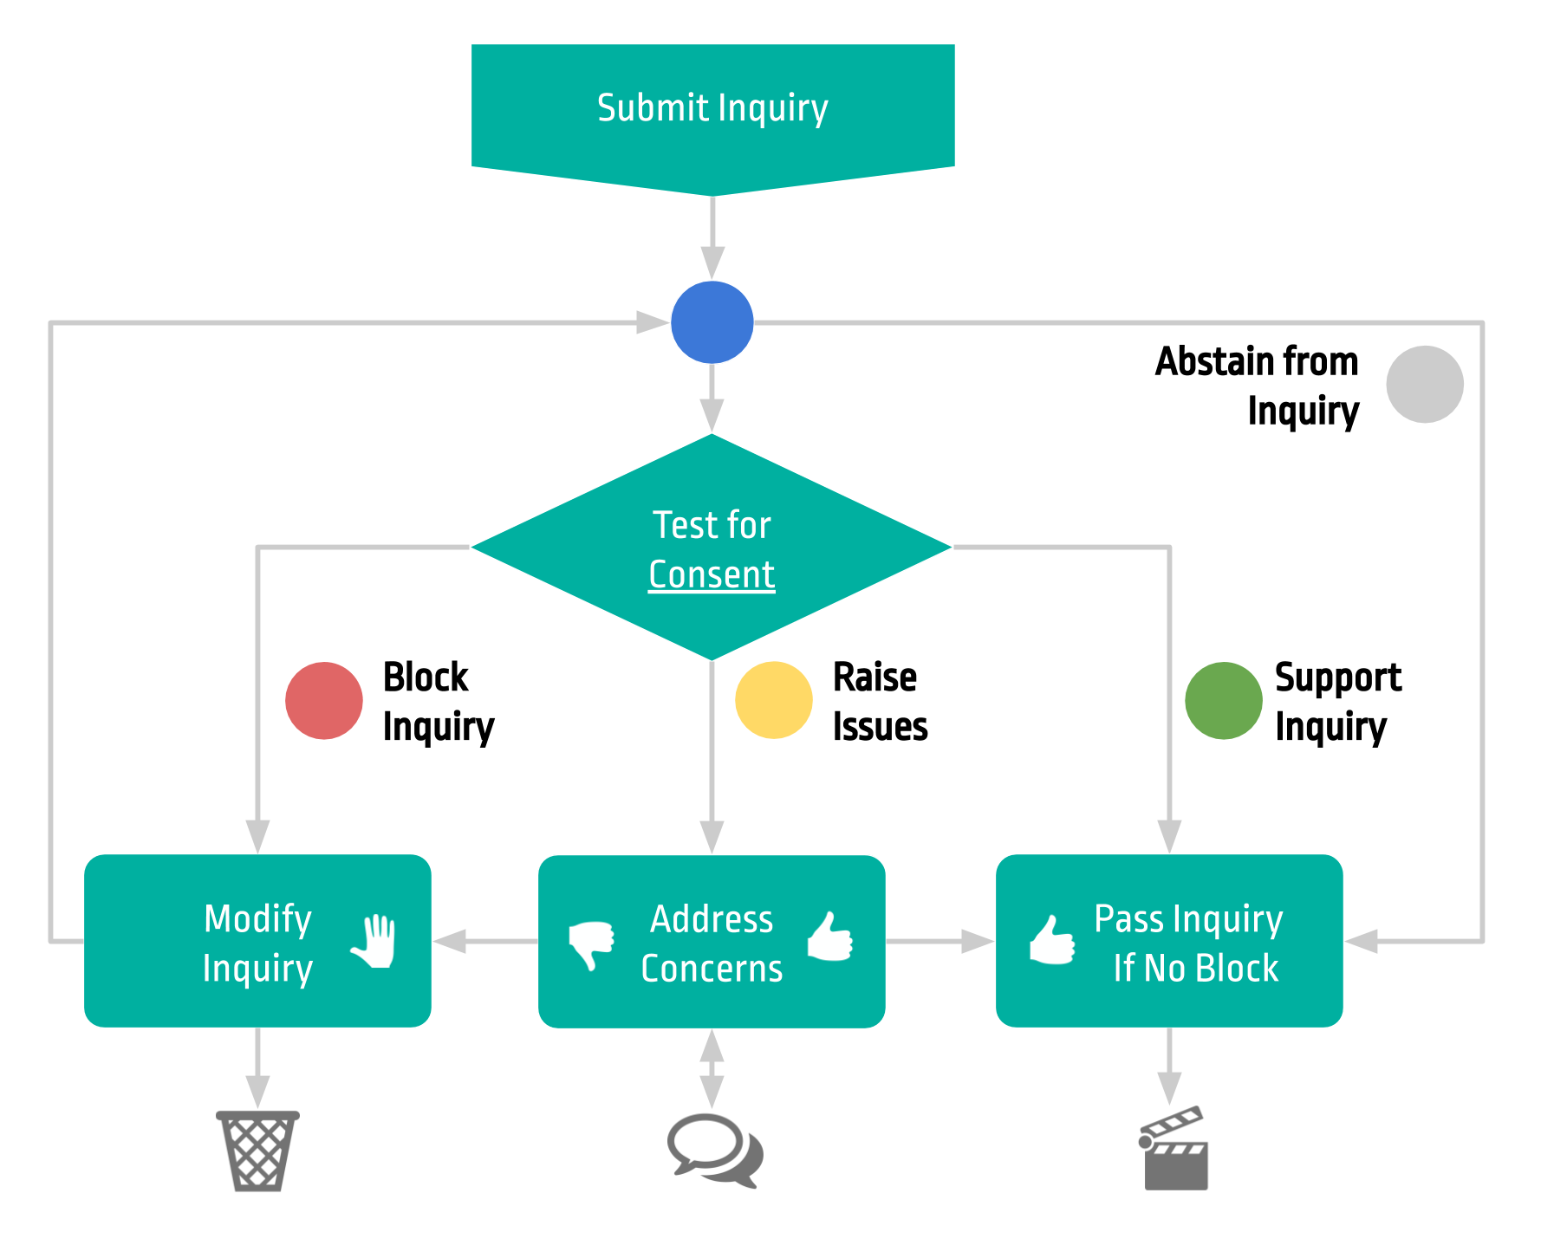
CONSENT
Many different voting methods can co-exist. Circles set natural boundaries for their scope.
If there is no objection in a given time frame, the vote passes. If there is an objection, it must be resolved before the vote passes.
0/0-20/1T1V/1WK
0% pass (Unity)
0-20% quorum (HVoice Voting)
Notes:
Token = Voice or Reputation

Slide 54
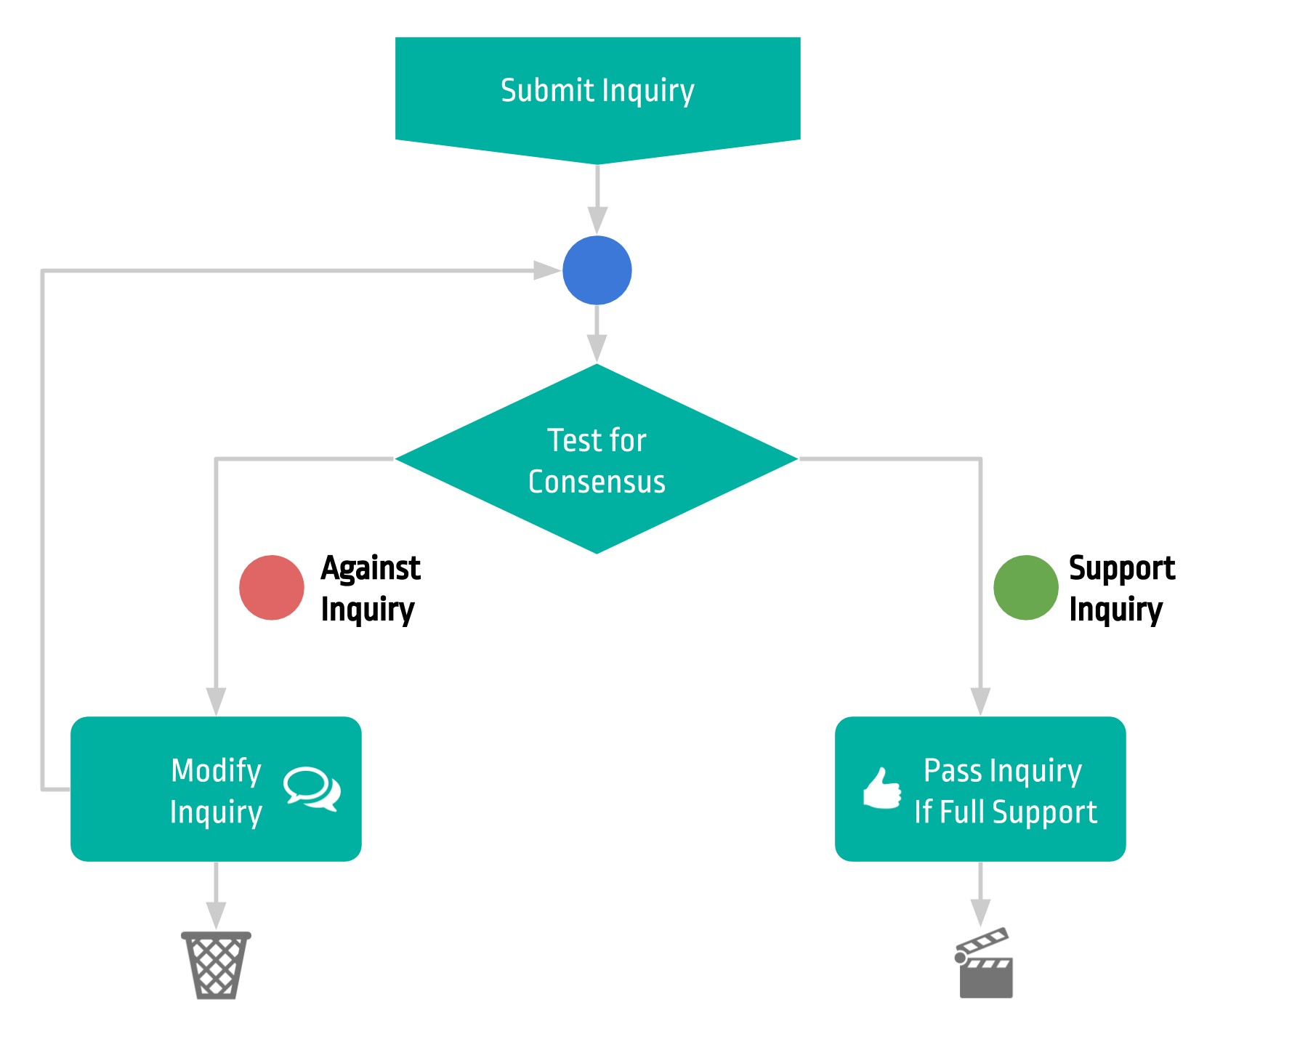
CONSENSUS
Many different voting methods can co-exist. Circles set natural boundaries for their scope.
If there is any objection in a given time frame, the vote does not pass. All votes must be in favor.
100/20/1T1V/1WK
100% pass (Unity)
20% quorum (HVoice Voting)
Notes:
Token = Voice or Reputation

Slide 55

TOKENS
Seeds is the currency of SEEDS.
Hypha Equity is the equity token of Hypha. Profits will be used to pay dividends to Hypha holders and to buy Hypha Equity to distribute to members. HUSD has a 1-to-1 value in USD and can be redeemed for US Dollar equivalent. Gratitude, DHO and many other tokens are coming soon.
Notes:
Token = Voice or Reputation

Slide 56
DIVISION
If the organism outgrows its capacity, purpose or membership bounds it divides into a new entity.
EVOLUTION
The DHO structure encourages spitting, evolving, growing and creating more diversity.

Slide 57






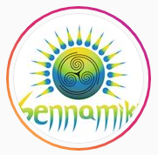







Organizations Hypha DHO
Sennamiki
UCI
LeCiel Foundation
Digital Life Collective
Organizations / Join Organization
APPLY NOW
APPLY NOW
APPLY NOW
APPLY NOW
Organization
Sennamiki
Organization
UCI
Organization
LeCiel Foundation
Organization
Digital Life Collective
JOIN
JOIN
JOIN
OPEN
APPLY NOW
The DAO will have a bioregional, organizational and village context & membership.
Organization
Terra Agora Foundation
OPEN
Notes:
https://www.iconbolt.com/iconsets/font-awesome-solid/handshake
https://www.countryflags.com/en/portugal-flag-icon.html

Slide 58

META ORGANISM
SEEDS is a meta-organism that is based on the same rules. While Hypha is a new type of organisation/business SEEDS is a new type of Civilization/Economy.
Organism (Hypha)
R
C
R
R
R
R
A
A
R
R
R
R
R
R
R
R
C
Q
R
R
R
A
A
A
R
A
A
A
C
R
R
A
A
A
A
Circle
C
R
A
A
A
A
A
A
A
A
A
A
A
A
Meta Organism (SEEDS)

Slide 59


WORK-PLAY- LEARN
Work - How we engage in physical or mental activity in order to achieve a purpose or result as a means of earning rewards and supporting your life and family.
Play - How we engage in activity for enjoyment through deep immersion and suspension of judgement rather than a serious or practical purpose.
Learn - How we gain an understanding of the world and acquire knowledge of or skill in something by study, experience, or being taught.
At the intersection of work, play and learn we have a zone of accelerated human potential.
WORK
WORK PLAY LEARN
PLAY
LEARN

Slide 60
CULTURAL SHIFT
The point of Hypha is to design a new type of method for human coordination at scale. An improvement method to joyfully meet our needs. For this Hypha considers all our human needs, not just the myopic focus on “making money”.
Play…
Decreases
Burnout
Turnover
Unproductive fighting
Tension as pain
Stress and anxiety
Myopic thinking
Increases
Creativity and joy
Commitment
Productive evolution
Tension as growth
Excitement
Learning
Notes:
Let’s not come down on each other - let’s agree that we’re in this together. I’ve noticed a toxic theme lately - a lot of infighting - pain, misunderstanding… I noticed this when we tried to bring in the budget and money started being a core theme - we need to detox. So, we’re detoxing Hypha as an organisation - but we also could use a cultural detox. Make commitments to show up with our values… Honesty - transparency -

Slide 61
Cultural Shift
Command & Control
Bias towards inaction (punishing improper action)
Hubris - assumption “I” know best
Telling others (outside your domain) what is proper
Emergence
Bias towards action (trials by inspiration)
Humility - assumption “we” know best
Activating and growing your role and purpose within your domain - collaborating with others when inspired
Notes:
Self autonomous wholes gives rise to the emerging order that will vastly exceed anything we could create.
So, we don't focus on "controlling" or "manipulating" humans. But rather evolving the system to better serve the emerging order that *SO* many humans are feeling and sensing but don’t yet have a shared space to build it. This is that shared space. SEEDS and Hypha offer new tools to build this new civilization
So, instead of "how do we get everyone to play the same game" it becomes "how do we get those playing the game to play it in a way that creates a new civilization"

Slide 62
Onchain vs off chain decisions Commons (tokens) on-chain governance Circle operational decisions - (Hybrid off/on chain)

Slide 63
Reputation Badges (so salaries aren’t the value signal - badges are). Harmonize Voice tokens (not equal to salary?). Badge multipliers …

Slide 64
Conflict resolution protocol
Conflict is tension - tension leads to growth - conflict is healthy - when someone is being discussed have them present.
Talk 1on1
Bring in Level up Arbiter
Collective sensing
Formal role/circle removal

Slide 65
ORGANISING PATTERNS, POLICIES AND PRINCIPLES
Roles have authority
New roles & projects are created/funded/dropped by HVoice Holders
Member/role sponsors
Hypha budget & circle budgets One cycle trials
The people filling roles don’t need permission to act (if it doesn’t impede another domain) and serve the purpose of their role.
The HVoice holders (Hypha Members) have the ultimate authority to drive the evolution of Hypha.
Every assignment is sponsored by an existing member. This “buddy system” ensures there’s a web of trust and wisdom. This sponsor is responsible for supporting this member in the game.
Circles are “mini DHO’s” All HVoice holders are responsible for the “Hypha Budget”. While Circle Members are responsible for their Circle Budgets.
When a member first applies for a role, it’s for a maximum 1 cycle. After the cycle there is a “check in” period and a re-application period for an extended role if applicable.

Slide 66
ORGANISING PATTERNS, POLICIES AND PRINCIPLES
Governance managed and evolved by HVoice Holders
Encourage cell-splitting - finance successful experiments
Fractal organising
Purpose, play, passion over coercion, control, cancer
Clear purpose accountabilities and domain
Understanding of the game.
The governance, policies, patterns, principles and all protocols are governed and evolved by the HVoice holders. All is up for evolution.
Healthy competition amongst multiple organs. Hypha thrives as it’s able to let members experiment with new circles and roles little risk - while being able to resource successes and cut (not people, roles) failures.
Every role is a mini circle and every circle is a mini DHO and every DHO is a mini economy...
We focus on the meta-objective of a “regenerative renaissance” we’re able to change the rules of the game and we bias ourselves towards creating a thriving system and not repeating cancerous patterns.
All roles, circles, DHO’s have a clear purpose, accountability and domain (optional) before being created. This gives them authority to act.
Notes:
Clear rules… If a circle wants to make decisions on various things together. It needs to be CLEAR how a decision is to be made.. Vagueness on who and how to act breeds inaction.

Slide 67
ORGANISING PATTERNS, POLICIES AND PRINCIPLES
Transparency and direct communication
Voice holders (self-organise) methods for receiving their voice
Change protocols before changing healthy people
Members govern the budget as an immune and evolution function
Bias towards full deferred for trial assignments
Roles have authority. If you need advice or need to engage with another roles domain. Go directly to them. Same with conflict.
Members are able to vote with their HVoice however they chose. Hypha encourages members to establish and publish transparent protocols for receiving their voice.
Hypha is meant to serve us, in our mission to create a new way of life. If protocols aren’t serving that mission we change the protocol before we attempt to change people.
HVoice holders are in control. What gets resources and what doesn’t is up to all the members according to their HVoice.
Hypha encourages members to defer all compensation for their first cycle of filling a role, if possible.
Notes:
Clear rules… If a circle wants to make decisions on various things together. It needs to be CLEAR how a decision is to be made.. Vagueness on who and how to act breeds inaction.

Slide 68
ORGANISING PATTERNS, POLICIES AND PRINCIPLES
Reflect how you’re showing up with your roles
If more than 3% of your time with Hypha is doing activities that are not part of your current roles, then this is a signal to create a new role and realign how you’re showing up with the roles you’re holding.
Notes:
Clear rules… If a circle wants to make decisions on various things together. It needs to be CLEAR how a decision is to be made.. Vagueness on who and how to act breeds inaction.

Slide 69
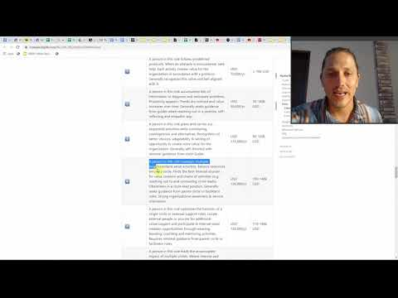
ROLE ASSIGNMENT AND PAY
Recurring compensation is based on the complexity of the role being filled and quality of contributions to Hypha (not prior experience). It’s important to note that all methods are lacking. What’s most important is that all members go through the same method.
*Circles may create their own compensation methods.
Watch the video or click this document for an overview of how complexity and commitment levels are assessed.
Notes:
Clear rules… If a circle wants to make decisions on various things together. It needs to be CLEAR how a decision is to be made.. Vagueness on who and how to act breeds inaction.

Slide 70
Evolving beyond the punishment of rewards
Everyone in Hypha is a master of their craft - let’s unleash that potential!
Intrinsic interests and passions over extrinsic rewards (pay) for motivation.
Promote unity and teamwork (we all thrive together).
We have the opportunity to create a new paradigm of work (read play/ co-creating) - we can co-create our own means.
We can be led by purpose and passion and create tools that can radically transform civilization. We're at the cutting edge of these new ideas.
Provide a stable income so we can focus on being passionate about the greater cause. Experiment with “Gratitude Tokens” to move towards decentralizing compensation.

Slide 71
Fun - Autonomous & Self Organising Aligning with Evolution with Complex Adaptive Systems
Change Systems Before People
Evolve and adapt the system if the output is not aligned with purpose - change the system - before attempting to change the people.
Autonomy, Diversity, Evolution
Giving people the ability to show up as they sense - create conditions for massive diversity - with ability to prune (immune system).

Slide 72
UNIQUE ORGANS
Here to serve the health and harmony of the organism and the people (cells, organs) that comprise it.
LEVEL UP
At the heart of Hypha is a “level up” team of coaches and empaths here to help others play the game and cultivate leaders - helping people “up-level” and serve purpose.
LAMPLIGHTER (Not a role)
Voted In
1. Sense their circle to the Collective Sensing meetings.
2. When something in their circle is unclear it is their role to engage in a governance process to make new accountabilities explicit.
SWEET TEAM
SWEET exists to bring recommendations and advice across circles. 1. Not authority figures, advisors. 2. SWEET roles participate in multiple circles to promote org coherence.
INTER CIRCLE FACILITATOR
1. ICF is voted on by all members (a separate role not within a circle). 2. This role sits in all circles voting in favour of org coherence.
Notes:
“Lamplighters have been an important part of Burning Man almost as long as Burning Man has been held in the desert. More than a public utility, the Lamplighters are a symbol of community, of participation, and clear sign that the day has passed, and that evening magic will soon be upon us.”
For us, lamplighters are holding an important link lead function of the circle to illuminate, to navigate and to celebrate our work. Picture each lantern carried further into the circles of the organization. Clear rules… If a circle wants to make decisions on various things together. It needs to be CLEAR how a decision is to be made.. Vagueness on who and how to act breeds inaction.

Slide 73
Human Organism
Hypha Organism

Slide 74

To Regeneration and Beyond
The reasons for simplifying and homogenising pay is to see that we’re all on equal footing.
That we’re all in this together.
This organisation structure is intentionally simplified - to give a foundation for members to evolve and build upon as needed without undue or burdensome rules for collaboration.
Now! Let’s get back to co-creating a globally regenerative and thriving civilization.

Slide 75

Regenerative Culture Reminder
"We are transitioning to a regenerative culture. It is a culture of respect and listening, in which people arrive on time to commitments and deal with conflicts when they arise, using short feedback loops to talk about disagreements and issues without blaming and shaming. It is a culture in which we cultivate healthy boundaries by slowing down our yes’ and returning tasks when we are unable to follow through. It is a healthy resilient culture built on care and support. It’s consciously choosing to arrive and maintain integrity to the central purpose of midwifing the new paradigm."

Slide 76
PATTERNS OF CO-CREATION (THE 5 C’S)
Pathway from connection to co-creation (with the collaboratory focusing on collaboration).
CONNECT
COMMUNICATE
COLLABORATE
COHERE
CO-CREATE
COLLABORATORY
[Vehicle for joyful & rewarding Collaboration]
ORG A
ORG B
ORG A
ORG B
ORG A
ORG B
VALUE EXCHANGE: Equity swaps, shared tools, shared events, etc
Notes:
Scale of orgs… Governance... Token Variety... Owner = Coherence Holder
Firefighters have “hierarchy”
Very first person in this role is the source
https://medium.com/@AhoiNadjeschda/who-s-idea-was-it-anyway-the-role-of-source-in-organizations-843b407e2879
https://www.youtube.com/watch?v=32vlOgN_3QQ

Slide 77

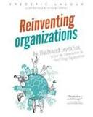


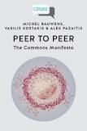
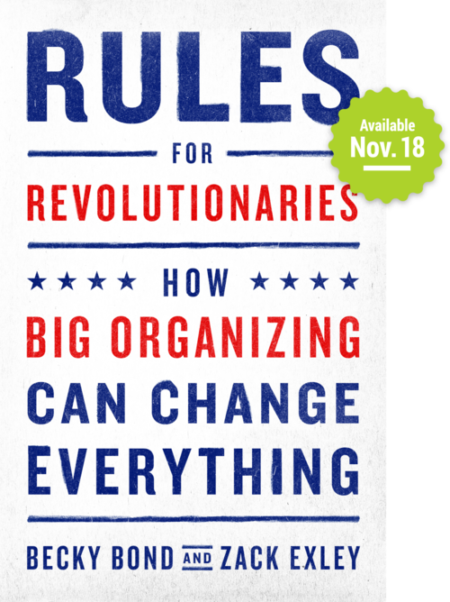



SEEDS
Bioregional Focus “Where we connect-communicate-coordinate.”
HYPHA
Organizational Focus
“Where we work-play-learn.”
The Currency & The Movement
Is a project of
The Accelerator & The Organization
Radical Transparency
Radical Honesty
Radical Responsibility
Radical Focus
Paid Volunteers
Paid Staff
DHO
Work Team
Village/ Retreat
Role
Role
Role
Role
Role
Role
Trial Balloons
Missions/Quests
Role
Role
Ambassadors
Marketeers
Creatives
Developers
Architects
Designers
Product Experiments & Pilots
Role
Role
Role
Role
BABY DHO
Role
Role
Adjacent Possible Symmathesy Warm Data
Bioregional Collaboratories
Organizational Collaboratories

Slide 78
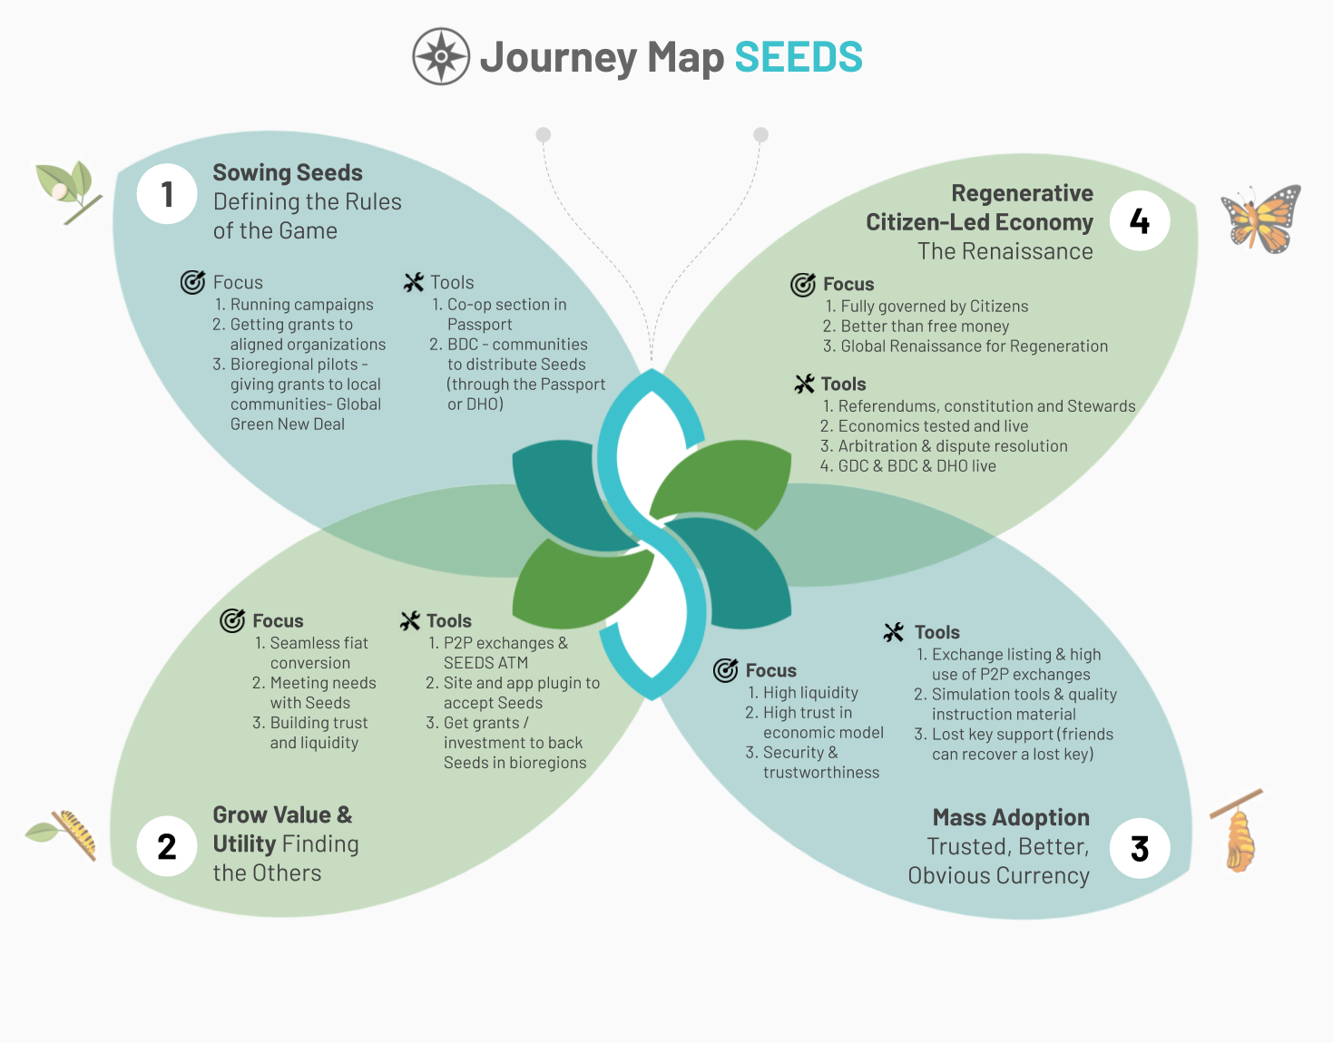
JOURNEY MAP
The map breaks our journey down into four distinct stages that each have a clear goal.
1 Sowing Seeds
The New Rules of the Game
2 Grow Value & Utility The Search for the Others
3 Mass Adoption
The Better Currency
4 Regenerative Citizen-Led Economy
The Economic Renaissance
Needs more thinking… JS
Revised now.. What think.. JS
Notes:
Note: contribution are not genesis contributions (tied to a role)
Commission-based
Salary-based
Ad-hoc compensation
Promissory-based

Slide 79

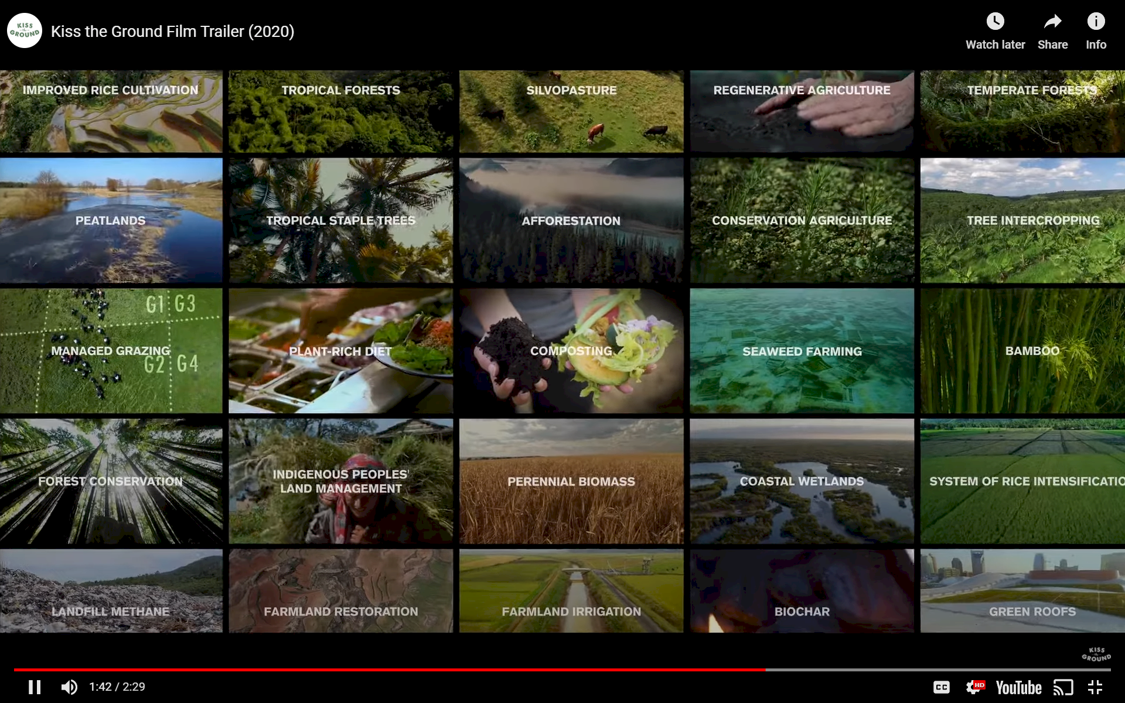




Hypha
Ontology
Evolution
Regenerative Living
Regenerative Education
Regenerative Forestation
DHO
Regenerative
Health
Regenerative Agriculture
Regenerative Finance
Notes:
https://medium.com/activate-the-future/what-is-regenerative-behaviour-47bb0f6b0bbe
https://earthwatch.org.uk/working-with-business/tiny-forests
http://regenerosity.com/ - Regenerosity is a system for recognition of voluntary service, philanthropy & gift, civic engagement, trade, commerce, work, and any other contributions to the health and wealth of our communities. If you are a member of any community, whether as a person, as a non-profit organization, or as a for-profit business, there is something in it for you. As a person, you receive recognition for voluntarism, philanthropy, civic service, and many other types of community-building participation. As a non-profit organization, you receive tools for volunteer & donor recognition and access to untapped sources of support. As a for-profit business, you receive tools for customer loyalty & econometrics and access to untapped sources of working capital. As a school, you receive interactive tools for teaching economics & civics and for promoting community service. Everyone receives tools for measurement and analysis of social capital (their own and that of their communities) and practical tools to build community self-reliance and sustainable local economy, including community-based mutual credit systems.

Slide 80



BODY OF PEOPLE MEETS OTHER ORGANISMS
Ultimately, the Body of People can be further uncoupled from the organizational or bioregional entity and become part of a much wider ecosystem.
An interim step can be the creation of a Collaboratory that allows multiple parties (multiple bodies of work) to tap into a shared body of people.
As organizations evolve and begin to overlap, more and more elements can be shared among participating entities, creating a seamless whole.
Village
Body of Work
Body of Knowledge
Indigenous Knowledge
Body of Work
Body of Work
Body of People
Body of Work
Body of Work
Body of Work
Body of Knowledge
Organizational Knowledge
Organization

Slide 81
QUESTS & CHALLENGES
New work types will be introduced to allow for time-bound contributions.
C
Q
C

Slide 82
VALUE CREATION In Hypha there are 3 ways to earn rewards for building and co-creating Hypha. Each method comes with its own trade-offs. High Responsibility
Others are counting on you to accomplish various tasks. High Freedom
You decide entirely how, where and when to contribute. High Financial Risk
You’re taking on the risk of not being compensated for your contribution.
*low would be the inverse of these descriptions.
Contribution Request
… when you hold a specific role in Hypha. Compensation and responsibilities are clear and agreed upfront.
Evaluation is continuous as other members decide whether to suspend or continue your role.
Lower freedom (specific tasks), high responsibility and lower financial risk.
Quest Reward
Freedom
Freedom
Low
High
Low
High
Responsibility
Responsibility
Financial Risk
Financial Risk
Role Assignment
...when you do something and then ask for compensation after the fact. In this case there was no official value agreed upfront and evaluation happens after the contribution occurs.
High freedom as you get to decide how/when to contribute. Higher risk as it may not pass.
… when you agree to a specific one-time task that has a reward (or booty) associated with it. Evaluation of success and rewards are distributed after various milestones are (or the whole quest is) done.
Freedom to accomplish quest as you see fit and medium risk for rewards.
Freedom
Low
High
Responsibility
Financial Risk
Notes:
This is what excites me about "Gratitude Tokens" and employing them (and other tools (TBD)) to assist in this Decentralized assessment and contribution accounting. We must remember we're all Hypha and if Hypha is always taking on all the risk this is a classic case of "tragedy of the commons" and we'll all fail. Meaning, people can't just show up, do something and always expect to be paid (if it wasn't agreed upon by Hypha) the only official contract/agreement in Hypha is in the DHO! That's where agreements are made and stored transparently and immutably. If someone wants their "potential" contribution paid upfront - they can attempt this approach with proactive contribution request.

Slide 83
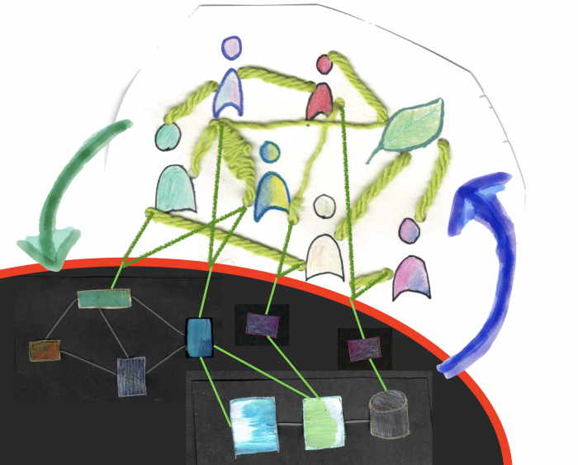
SYMMATHESY
Symmathesy (Noun): An entity composed by contextual mutual learning through interaction. This process of interaction and mutual learning takes place in living entities at larger or smaller scales of symmathesy.
Symmathesy (Verb): to interact within multiple variables to produce a mutual learning context.
This flow of mutual learning means the system is never the same. It is always changing, and its participants are always changing.
https://medium.com/@jessitron/symmathecist-n-c728957ce71f

Slide 84
FLOW
Hypha members enable different kinds of flows with Trust Flows at the core, removing barriers and inertia. Value Flows and Network flows reach beyond the boundaries of the organization, Information and Workflows weave interna flows. Data and Knowledge Commons complement Social and Financial Ledgers building a shared foundation open for all to participate.
Network Flow
Information & Work Flow
Trust Flow
Value Flow
Data Commons
Social & Financial Ledgers
Knowledge Commons

Slide 85


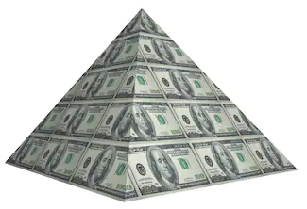
PARADIGM
“COMPETITION”
We're competing against Hollywood, Social Media, Virtual Reality, etc for mindshare. Hypha needs to be more rewarding, fun and fulfilling. We’re competing against our current economic and political systems who want to control humanity. We're playing an "infinite game" where we can redesign how and what humans can create together.
The people we want to play with are the ones who aren't doing it for money as a “job”. Sure, money may be a consequence - but that shouldn't be the reason. We’re building a new civilization and we want to attract those eager to play a game at this level.
Watch TV or co-create with Hypha?
Self Organised Chaos
Top-down control
Top down control creates fragile ecosystems with myriad bottlenecks and growth containers that require excess energy to constantly resist entropy. More fragile with growth.
Middle-out complexity
Organising patterns give rise to ordered complexity and complex adaptive systems.
More antifragile with growth.

Slide 86
